Slide 1

Knowledge Representation

Slide 2

HEADLINES
What is Knowledge?
Types of Knowledge
Knowledge Representation (KR) and methods
Approaches to KR
Issues in KR

Slide 3
What is Knowledge?
expertise, and skills acquired by a person through experience or education; the theoretical or practical understanding of a subject.
what is known in a particular field or in total; facts and information.
awareness or familiarity gained by experience of a fact or situation.

Slide 4
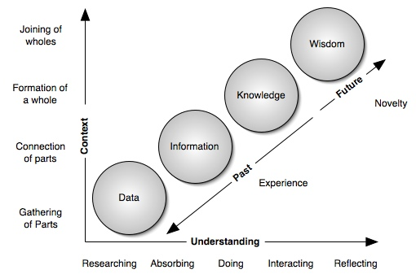
What is Knowledge?

Slide 5
Types of Knowledge
Logical
Semantic
Systematic
Empirical

Slide 6
Logical Knowledge
Logical knowledge is not expressed as data or procedure.
It's expressed as relationships.
It might be expressed as rules or in tables showing conditions and implied results, or as a graph showing connections.
Example:
If a is more than b, and b is more than c, then a is more than c.

Slide 7
Semantic Knowledge
Semantic knowledge is long-established knowledge about objects, facts, and word meanings.
This type of knowledge is the result of learning the meanings of words.
Example:
A bachelor is an unmarried male.

Slide 8
Systematic Knowledge
This type of knowledge consists of concepts of Mathematics and Geometry, which are the result of learning a system of words or symbols, and how they relate to one another along with the rules of operating in that system and any claims made that are consistent with those definitions and rules.
Example:
> There are three sides to a triangle. The sum of their angles is 180 degrees.
> 23 + 11= 34

Slide 9
Empirical Knowledge
This is knowledge that comes through our senses.
Observation, formulation of a hypothesis, careful observation, testing and experimentation, confirmation or falsification of the hypothesis.
Example:
There is a whiteboard in front of you right now.

Slide 10
Knowledge Acquisition
Process of adding new knowledge to a knowledge data base and refining or improving knowledge that was previously acquired.
Acquired Knowledge consists of: facts, rules, concepts, procedures, relationships, etc.
fact : {snow is white}
relation : {father of Abhishek is Amitabh}
Rules : {if (temp >= 100 degrees) (water boils)
}

Slide 11
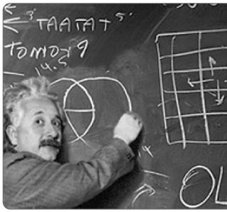
Knowledge Acquisition:How?

Slide 12
How is knowledge acquired?
General Learning Model
Through learning
Stimuli
Learner
Component
Feedback
Environment
Critic/
Performance
Evaluator
Knowledge
Base
Response
Performance
Components
Tasks

Slide 13

What is Knowledge Representation?
SURROGATE
  a substitute for the thing itself.
Set of ONTOLOGICAL commitments
  a set of concepts within a domain, and the relationships between those concepts.
  an answer to the question.
Theory of INTELLIGENT reasoning
  the logical view and set of inferences.
Medium for efficient COMPUTATION
  the computational environment in which thinking is accomplished.
Medium of human EXPRESSIONS
  a language in which we say things about the world.

Slide 14
Representation of Facts
Facts: things we want to represent.
Representations of facts: things we can manipulate.

Slide 15
Representation of Facts
reasoning programs
Facts
Internal
Representations
English understanding
English generation
English
Representations

Slide 16
Representation of Facts
Initial
facts
desired real reasoning
Final
facts
forward representation mapping
backward representation mapping
Internal
representations
of initial facts
Internal
representations
of final facts
operation of program

Slide 17
Representation of Facts
Scooby is a dog.
Every dog has a tail.
Hence
Scooby has a tail.

Slide 18
Representation of Facts
Scooby is a dog
dog(Scooby)
Every dog has a tail
∀x: dog(x) → hastail(x)
hastail(Scooby)
Scooby has a tail

Slide 19
Approaches to KR
Representational adequacy: ability to represent all kinds of knowledge that are needed in that domain.
Inferential adequacy: ability to manipulate the representational structures in such a way as to derive new structures corresponding to new knowledge inferred from old.
Inferential efficiency: ability to incorporate into the knowledge structures additional information that can be used to focus the attention of the inference mechanisms in the most promising directions.
Acquisitional efficiency: ability to acquire new information easily. Direct insertion of new knowledge into database.

Slide 20
ISSUES IN KNOWLEDGE REPRESENTATION

Slide 21
Issues that arises while KR techniques:
Important Attributes
Relationships among Attributes.
Choosing the granularity of Representation.
Representing Sets of Objects.
Finding the Right structures as Needed

Slide 22
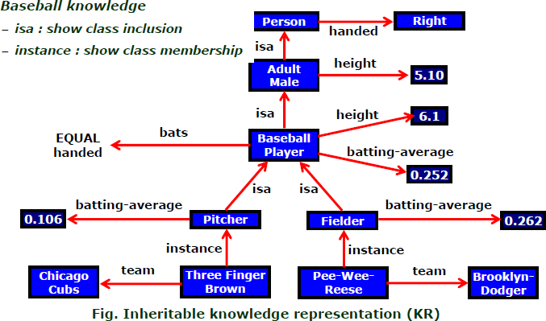

Slide 23
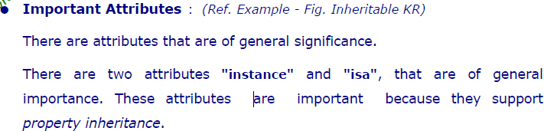
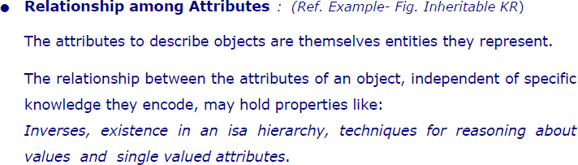

Slide 24
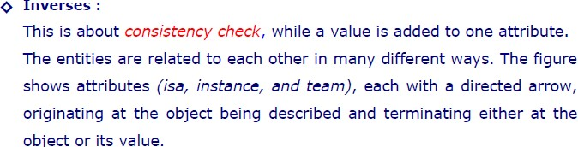

Slide 25
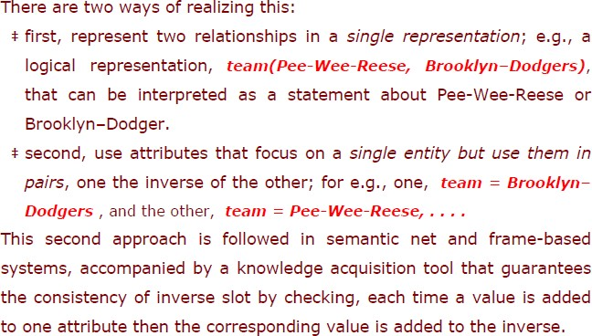

Slide 26
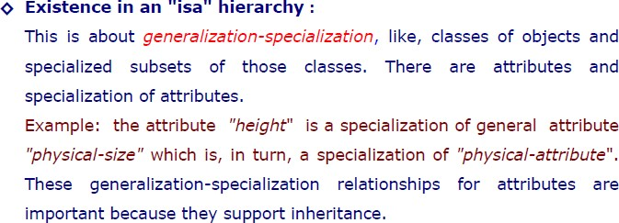
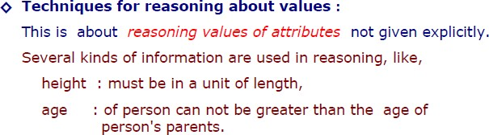

Slide 27
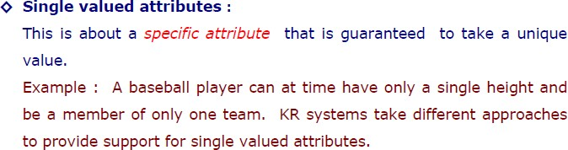

Slide 28
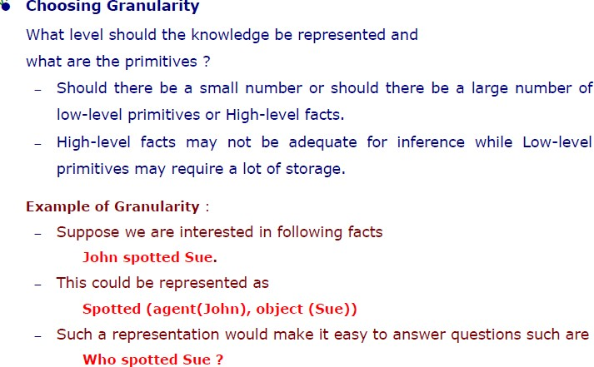
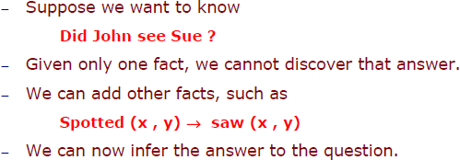

Slide 29
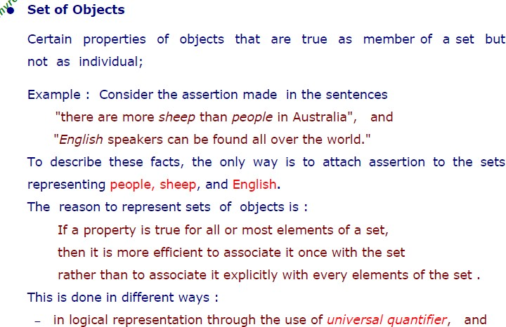
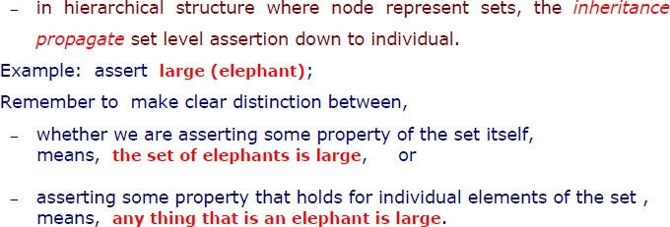

Slide 30
